Slide 1

R Functions:
What are they and when should you use them

Slide 2

Basic R Functions
sum()
?sum()
sum(…, na.rm = FALSE)
… ← basically means that this function can take in a number of arguments and still work
na.rm ← whether to remove or keep NA values

Slide 3
User Generated Functions
function_name <- function(arguments go here){function code goes here}
function_name ← this will be what the function is called
When a new function is run, a new subsection will appear in your global environment with all the user defined functions you have run
function() ← this will be where arguments for your function are listed (more on this next)
{} ← inside the curly brackets will be where you code what your function does given the inputs for the function

Slide 4
Example Function
library(lubridate)
date_blast_func <- function(df = in_df, d_format = "%m/%d/%Y",d_name = "datetime"){
df[,d_name] <- as.Date(df[,d_name], format = d_format)
df$year <- year(df[,d_name])
df$month <- month(df[,d_name])
df$day <- day(df[,d_name])
df$yday <- yday(df[,d_name])
return(df)
}

Slide 5
Example Function
data frame variable
library(lubridate)
date_blast_func <- function(df = in_df, d_format = "%m/%d/%Y",d_name = "datetime"){
df[,d_name] <- as.Date(df[,d_name], format = d_format)
df$year <- year(df[,d_name])
df$month <- month(df[,d_name])
df$day <- day(df[,d_name])
df$yday <- yday(df[,d_name])
return(df)
}

Slide 6
Example Function
format of the date
library(lubridate)
date_blast_func <- function(df = in_df, d_format = "%m/%d/%Y",d_name = "datetime"){
df[,d_name] <- as.Date(df[,d_name], format = d_format)
df$year <- year(df[,d_name])
df$month <- month(df[,d_name])
df$day <- day(df[,d_name])
df$yday <- yday(df[,d_name])
return(df)
}

Slide 7
Example Function
Name of the date column
library(lubridate)
date_blast_func <- function(df = in_df, d_format = "%m/%d/%Y",d_name = "datetime"){
df[,d_name] <- as.Date(df[,d_name], format = d_format)
df$year <- year(df[,d_name])
df$month <- month(df[,d_name])
df$day <- day(df[,d_name])
df$yday <- yday(df[,d_name])
return(df)
}

Slide 8
Example Function
library(lubridate)
date_blast_func <- function(df = in_df, d_format = "%m/%d/%Y",d_name = "datetime"){
df[,d_name] <- as.Date(df[,d_name], format = d_format)
df$year <- year(df[,d_name])
df$month <- month(df[,d_name])
df$day <- day(df[,d_name])
df$yday <- yday(df[,d_name])
return(df)
}
Reformats a character into a date

Slide 9
Example Function
library(lubridate)
date_blast_func <- function(df = in_df, d_format = "%m/%d/%Y",d_name = "datetime"){
df[,d_name] <- as.Date(df[,d_name], format = d_format)
df$year <- year(df[,d_name])
df$month <- month(df[,d_name])
df$day <- day(df[,d_name])
df$yday <- yday(df[,d_name])
return(df)
}
Makes columns for year, month, day, and year day

Slide 10
Example Function
library(lubridate)
date_blast_func <- function(df = in_df, d_format = "%m/%d/%Y",d_name = "datetime"){
df[,d_name] <- as.Date(df[,d_name], format = d_format)
df$year <- year(df[,d_name])
df$month <- month(df[,d_name])
df$day <- day(df[,d_name])
df$yday <- yday(df[,d_name])
return(df)
}
Returns the new data frame

Slide 11
Running the Example Function
Step 1: Run your function code
date_blast_func <- function(df = in_df, d_format = "%m/%d/%Y",d_name = "datetime"){
df[,d_name] <- as.Date(df[,d_name], format = d_format)
df$year <- year(df[,d_name])
df$month <- month(df[,d_name])
df$day <- day(df[,d_name])
df$yday <- yday(df[,d_name])
return(df)
}
Step 2: Use your function
San_Diego_Temp_data <- date_blast_func(df = San_Diego_Temp_data, d_format = “%m-%d-%Y”, d_name = “Date”)

Slide 12
Questions?

Slide 13
Common Uses of Functions
Write a function for:
A common set of data processing steps
A complex grouping of steps we want applied over a list or dataframe (apply, lapply)
A common analysis using multiple datasets/variables with the same data structure
Automatically generating figures with multiple analysis output datasets with the same structure
There are many more functions for functions!

Slide 14
Common Uses of Functions
Write a function for:
A common set of data processing steps (see Example Function)
A complex grouping of steps we want applied over a list or dataframe (apply, lapply)
A common analysis using multiple datasets/variables with the same data structure
Automatically generating figures with multiple analysis output datasets with the same structure
There are many more functions for functions!

Slide 15
Common Uses of Functions
Write a function for:
A common set of data processing steps (see Example Function)
A complex grouping of steps we want applied over a list or dataframe (apply, lapply)
A common analysis using multiple datasets/variables with the same data structure
Automatically generating figures with multiple analysis output datasets with the same structure
There are many more functions for functions!

Slide 16
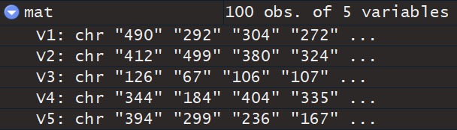
Example function for apply
We have a data frame called “mat” with columns V1-V5

Slide 17
Example function for apply
We have a data frame called “mat” with columns V1-V5
Let’s pretend this is count data we’ve read in to our Rstudio

Slide 18
Example function for apply
We have a data frame called “mat” with columns V1-V5
Let’s pretend this is count data we’ve read in to our Rstudio
For this example we want to convert the characters to numeric, take the sum of the column, and round the sum to the closest whole number
There are two ways to go about this:

Slide 19
Example function for apply
We have a data frame called “mat” with columns V1-V5
Let’s pretend this is count data we’ve read in to our Rstudio
For this example we want to convert the characters to numeric, take the sum of the column, and round the sum to the closest whole number
There are two ways to go about this:
Write the function within the apply statement:
apply(mat, 2, function(x) x %>%
as.numeric %>%
sum(na.rm = TRUE) %>%
round(digits = 0))

Slide 20
Example function for apply
We have a data frame called “mat” with columns V1-V5
Let’s pretend this is count data we’ve read in to our Rstudio
For this example we want to convert the characters to numeric, take the sum of the column, and round the sum to the closest whole number
There are two ways to go about this:
Write the function, then add it to an apply statement
summary_func <- function(x){
x <- x %>%
as.numeric %>%
sum(na.rm = TRUE) %>%
round(digits = 0)
return(x)
}
apply(mat, 2, summary_func)

Slide 21
Common Uses of Functions
Write a function for:
A common set of data processing steps (see Example Function)
A complex grouping of steps we want applied over a list or dataframe (apply, lapply)
A common analysis using multiple datasets/variables with the same data structure
Automatically generating figures with multiple analysis output datasets with the same structure
There are many more functions for functions!

Slide 22
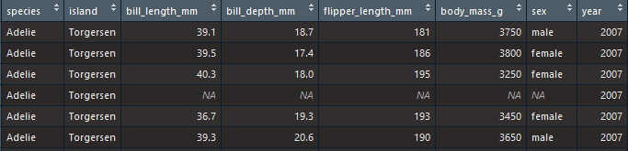
Example function for analysis over multiple datasets/variables
Let’s look at the penguins dataset from the palmerpenguins R library
What if we want to run a simple linear model (lm) with a few driving variables and a few response variables?
How can we use functions to make this process easier?

Slide 23
Example function for analysis over multiple datasets/variables
First let’s compile a list of response variables and driving variables
response_list <- c("bill_length_mm", "bill_depth_mm", "flipper_length_mm", "body_mass_g")
driving_list <- c("species", "island", "sex", "year")

Slide 24
Example function for analysis over multiple datasets/variables
First let’s compile a list of response variables and driving variables
response_list <- c("bill_length_mm", "bill_depth_mm", "flipper_length_mm", "body_mass_g")
driving_list <- c("species", "island", "sex", "year")
Now we write an analysis function:
lm_function <- function(response = response_list[i], driver = driving_list[j], df = penguins){
df <- as.data.frame(df) # convert tibble to df
df$response <- df[,response] # make response and driver variables
df$driver <- df[,driver]
lm_summary <- summary(lm(response~driver, data = df)) # run linear model
return(list(response = response, driver = driver,
lm_summary = lm_summary, adj_r_sq = lm_summary$adj.r.squared)) # return a list of analysis variables
}

Slide 25
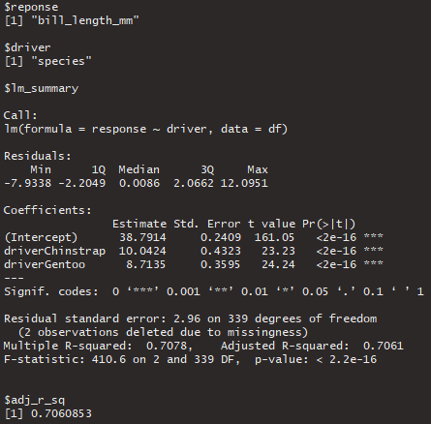
Example function for analysis over multiple datasets/variables
First let’s compile a list of response variables and driving variables
response_list <- c("bill_length_mm", "bill_depth_mm", "flipper_length_mm", "body_mass_g")
driving_list <- c("species", "island", "sex", "year")
Now we write an analysis function:
lm_function <- function(response = response_list[i], driver = driving_list[j], df = penguins){
df <- as.data.frame(df) # convert tibble to df
df$response <- df[,response] # make response and driver variables
df$driver <- df[,driver]
lm_summary <- summary(lm(response~driver, data = df)) # run linear model
return(list(response = response, driver = driver,
lm_summary = lm_summary, adj_r_sq = lm_summary$adj.r.squared)) # return a list of analysis variables
}

Slide 26
Example function for analysis over multiple datasets/variables
Now let’s run this analysis over all response variables and all driving variables
(we’ll do this in a loop for now, though you can think about how to do this in an apply statement) ← expand.grid()

Slide 27
Example function for analysis over multiple datasets/variables
output_list <- list()
for (i in 1:length(response_list)) {
by_response_list <- list()
for (j in 1:length(driving_list)) {
by_response_list[[j]] <- lm_function(response = response_list[i], driver = driving_list[j], df = penguins)
}
output_list[[i]] <- by_response_list
}

Slide 28
Example function for analysis over multiple datasets/variables
output_list <- list()
for (i in 1:length(response_list)) {
by_response_list <- list()
for (j in 1:length(driving_list)) {
by_response_list[[j]] <- lm_function(response = response_list[i], driver = driving_list[j], df = penguins)
}
output_list[[i]] <- by_response_list
}
Here is our function,
see how it is running per i^{th} response variable and j^{th} driving variable

Slide 29
Example function for analysis over multiple datasets/variables
output_list <- list()
for (i in 1:length(response_list)) {
by_response_list <- list()
for (j in 1:length(driving_list)) {
by_response_list[[j]] <- lm_function(response = response_list[i], driver = driving_list[j], df = penguins)
}
output_list[[i]] <- by_response_list
}
Here we’re storing all driving variable summaries into a list per response variable

Slide 30
Example function for analysis over multiple datasets/variables
output_list <- list()
for (i in 1:length(response_list)) {
by_response_list <- list()
for (j in 1:length(driving_list)) {
by_response_list[[j]] <- lm_function(response = response_list[i], driver = driving_list[j], df = penguins)
}
output_list[[i]] <- by_response_list
}
Finally we compile all response variable lists into one master output list

Slide 31
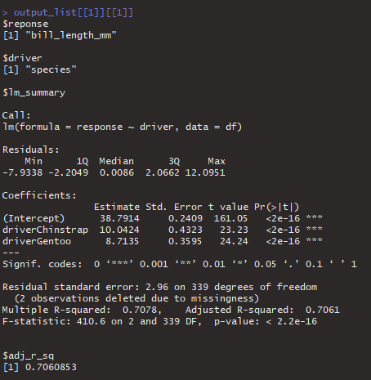
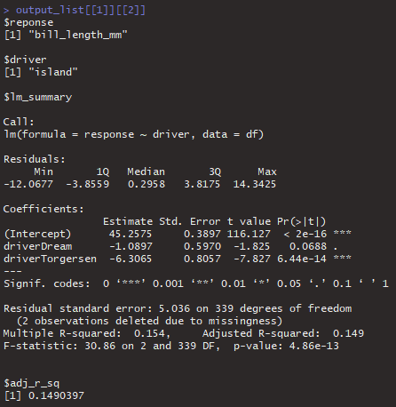
Example function for analysis over multiple datasets/variables
What our output looks like:
If we access the second level of our list (output_list[[i]][[j]] ← this part)

Slide 32
Example function for analysis over multiple datasets/variables
What our output looks like:
If we access the second level of our list (output_list[[i]][[j]] ← this part)
We see that we are looking at the same response variable, but are looking at different driving variables

Slide 33
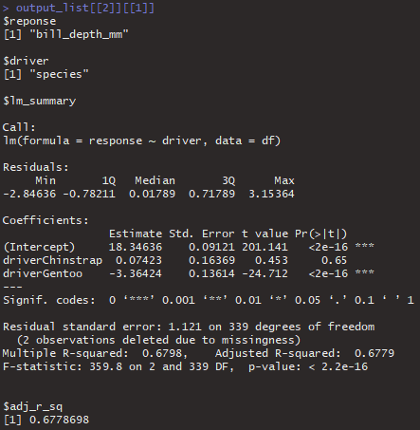
Example function for analysis over multiple datasets/variables
What our output looks like:
If we access the first level of our list (output_list[[i]][[j]])

Slide 34
Example function for analysis over multiple datasets/variables
What our output looks like:
If we access the first level of our list (output_list[[i]][[j]])
We see that we are looking at different response variables, but at the same driving variable

Slide 35
Questions?

Slide 36
Common Uses of Functions
Write a function for:
A common set of data processing steps (see Example Function)
A complex grouping of steps we want applied over a list or dataframe (apply, lapply)
A common analysis using multiple datasets/variables with the same data structure
Automatically generating figures with multiple analysis output datasets with the same structure
There are many more functions for functions!

Slide 37
Before we make a function for figures…
Let’s be sneaky and include all the things we need into our output from the analysis

Slide 38
Before we make a function for figures…
Let’s be sneaky and include all the things we need into our output from the analysis
lm_function <- function(response = response_list[i], driver = driving_list[j], df = penguins){
df <- as.data.frame(df) # convert tibble to df
df$response <- df[,response] # make response and driver variables
df$driver <- df[,driver]
lm_summary <- summary(lm(response~driver, data = df)) # run linear model
df <- df[,c("response", "driver")]
return(list(reponse = response, driver = driver,
lm_summary = lm_summary, adj_r_sq = lm_summary$adj.r.squared,
df = df)) # return a list of analysis variables
}

Slide 39
Example Function for plotting
plot_function <- function(plot_data = output_list[[i]][[j]],
output_pdf = paste0("figures/", output_list[[i]][[j]]$reponse, "_",output_list[[i]][[j]]$driver,"_violin_plot.pdf")){
Here we’re going to pull in parts of our output list and name that plot_data
Then we are going to generate a pdf file for each plot
Example of what paste0() would generate if: (i = 1, j = 1)
"figures/bill_length_mm_species_violin_plot.pdf"

Slide 40
Example Function for plotting
plot_function <- function(plot_data = output_list[[i]][[j]],
output_pdf = paste0("figures/", output_list[[i]][[j]]$reponse, "_",output_list[[i]][[j]]$driver,"_violin_plot.pdf")){
plot <- ggplot(plot_data$df, aes(x = as.factor(driver), y= response, fill = as.factor(driver))) +
geom_violin() + geom_jitter(width = 0.1) +
theme_bw() + labs(fill = driver) +
xlab(driver) + ylab(response) +
ggtitle(paste0(response," ~ ",driver))
In this case I am forcing each driving variable to be a factor

Slide 41
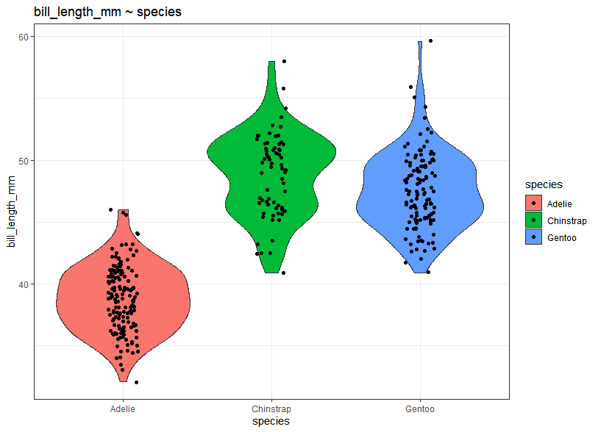
Example Function for plotting
plot_function <- function(plot_data = output_list[[i]][[j]],
output_pdf = paste0("figures/", output_list[[i]][[j]]$reponse, "_",output_list[[i]][[j]]$driver,"_violin_plot.pdf")){
plot <- ggplot(plot_data$df, aes(x = as.factor(driver), y= response, fill = as.factor(driver))) +
geom_violin() + geom_jitter(width = 0.1) +
theme_bw() + labs(fill = driver) +
xlab(driver) + ylab(response) +
ggtitle(paste0(response," ~ ",driver))

Slide 42
Example Function for plotting
plot_function <- function(plot_data = output_list[[i]][[j]],
output_pdf = paste0("figures/", output_list[[i]][[j]]$reponse, "_",output_list[[i]][[j]]$driver,"_violin_plot.pdf")){
plot <- ggplot(plot_data$df, aes(x = as.factor(driver), y= response, fill = as.factor(driver))) +
geom_violin() + geom_jitter(width = 0.1) +
theme_bw() + labs(fill = driver) +
xlab(driver) + ylab(response) +
ggtitle(paste0(response," ~ ",driver))
pdf(file = output_pdf, width = 6, height = 4)
print(plot)
dev.off()
}
← Saving the plot here

Slide 43
Example Function for plotting
plot_function <- function(plot_data = output_list[[i]][[j]],
output_pdf = paste0("figures/", output_list[[i]][[j]]$reponse, "_",output_list[[i]][[j]]$driver,"_violin_plot.pdf")){
plot <- ggplot(plot_data$df, aes(x = as.factor(driver), y= response, fill = as.factor(driver))) +
geom_violin() + geom_jitter(width = 0.1) +
theme_bw() + labs(fill = driver) +
xlab(driver) + ylab(response) +
ggtitle(paste0(response," ~ ",driver))
pdf(file = output_pdf, width = 6, height = 4)
print(plot)
dev.off()
}
Other options could be:
Storing the plots in a list
plot_list[[i]][[j]] <- plot
Printing out the plots to view in Rstudio
print(plot)

Slide 44
Running the plot function
for (i in 1:length(response_list) ) {
for(j in 1:length(driving_list)){
plot_function(plot_data = output_list[[i]][[j]],
output_pdf = paste0("figures/",output_list[[i]][[j]]$reponse,
"_",output_list[[i]][[j]]$driver,
"_violin_plot.pdf"))
}
}

Slide 45
Questions?

Slide 46
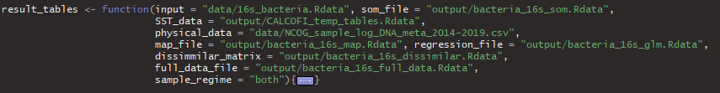
Example of a complex function
Here is an example analysis function I use in my work
The main input is a .Rdata file that includes an ASV x Sample relative abundance table
Other inputs include:
Physical data associated with each sample (temp, salinity, ect.)
Gridded SST
In this particular function I am breaking apart my analysis outputs into separate files:
Output from a self-organizing map (SOM)
6-year mean and standard deviation of calculated variables for mapping (richness, evenness, ect.)
Bray-Curtis Dissimilarity matrix (Sample x Sample matrix of BC values)
Per sample output of calculated variables (richness, evenness, ect.)
I also have a variable known as “sample_regime” which allows me to filter the entire dataset to look at either surface samples, deep chlorophll max samples, or both

Slide 47
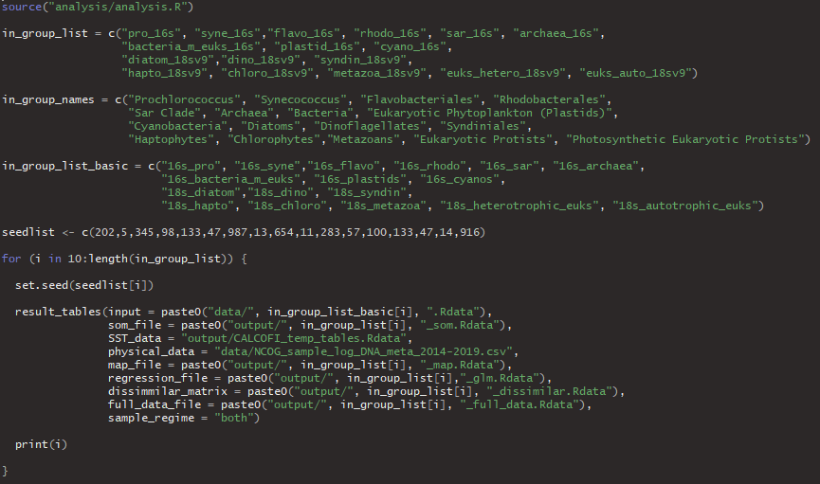
Application of a complex function
Source the script with my function

Slide 48
Application of a complex function
Here I am making sure my naming of files, figures, outputs are consistent and maintained through the function

Slide 49
Application of a complex function
Since some of my analysis can vary with each run, I set the seed for each group, then if I want to re-run something my outputs/figures are consistent

Slide 50
Application of a complex function
Here I am running my function within a for loop, though there are other ways I could do this (apply, parallel)

Slide 51
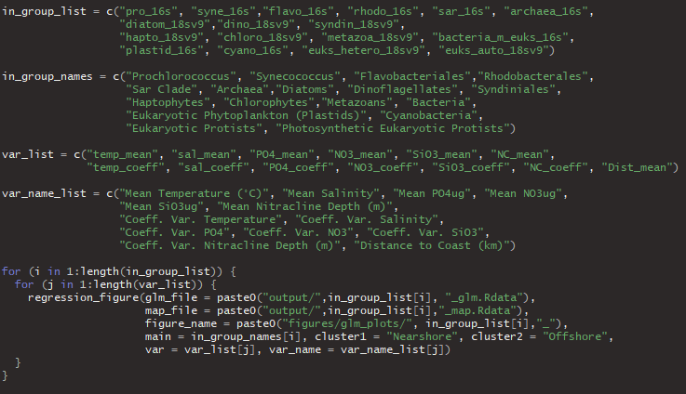
Complex Plot Function

Slide 52
Complex Plot Function
Why so many lists?
Here I am trying to make plotting as easy as possible.
I have lists for certain file names as well as lists for title/axis names

Slide 53
Final
Questions?

